Slide 1
Module 2: Linux Session
Getting started
2: Linux Session
3: Using Files and Directories
4: Editing Text

Slide 2
Contents
System access
Shells
Command line structure
Help
Fact finding commands

Slide 3
System access
Logging in

Slide 4
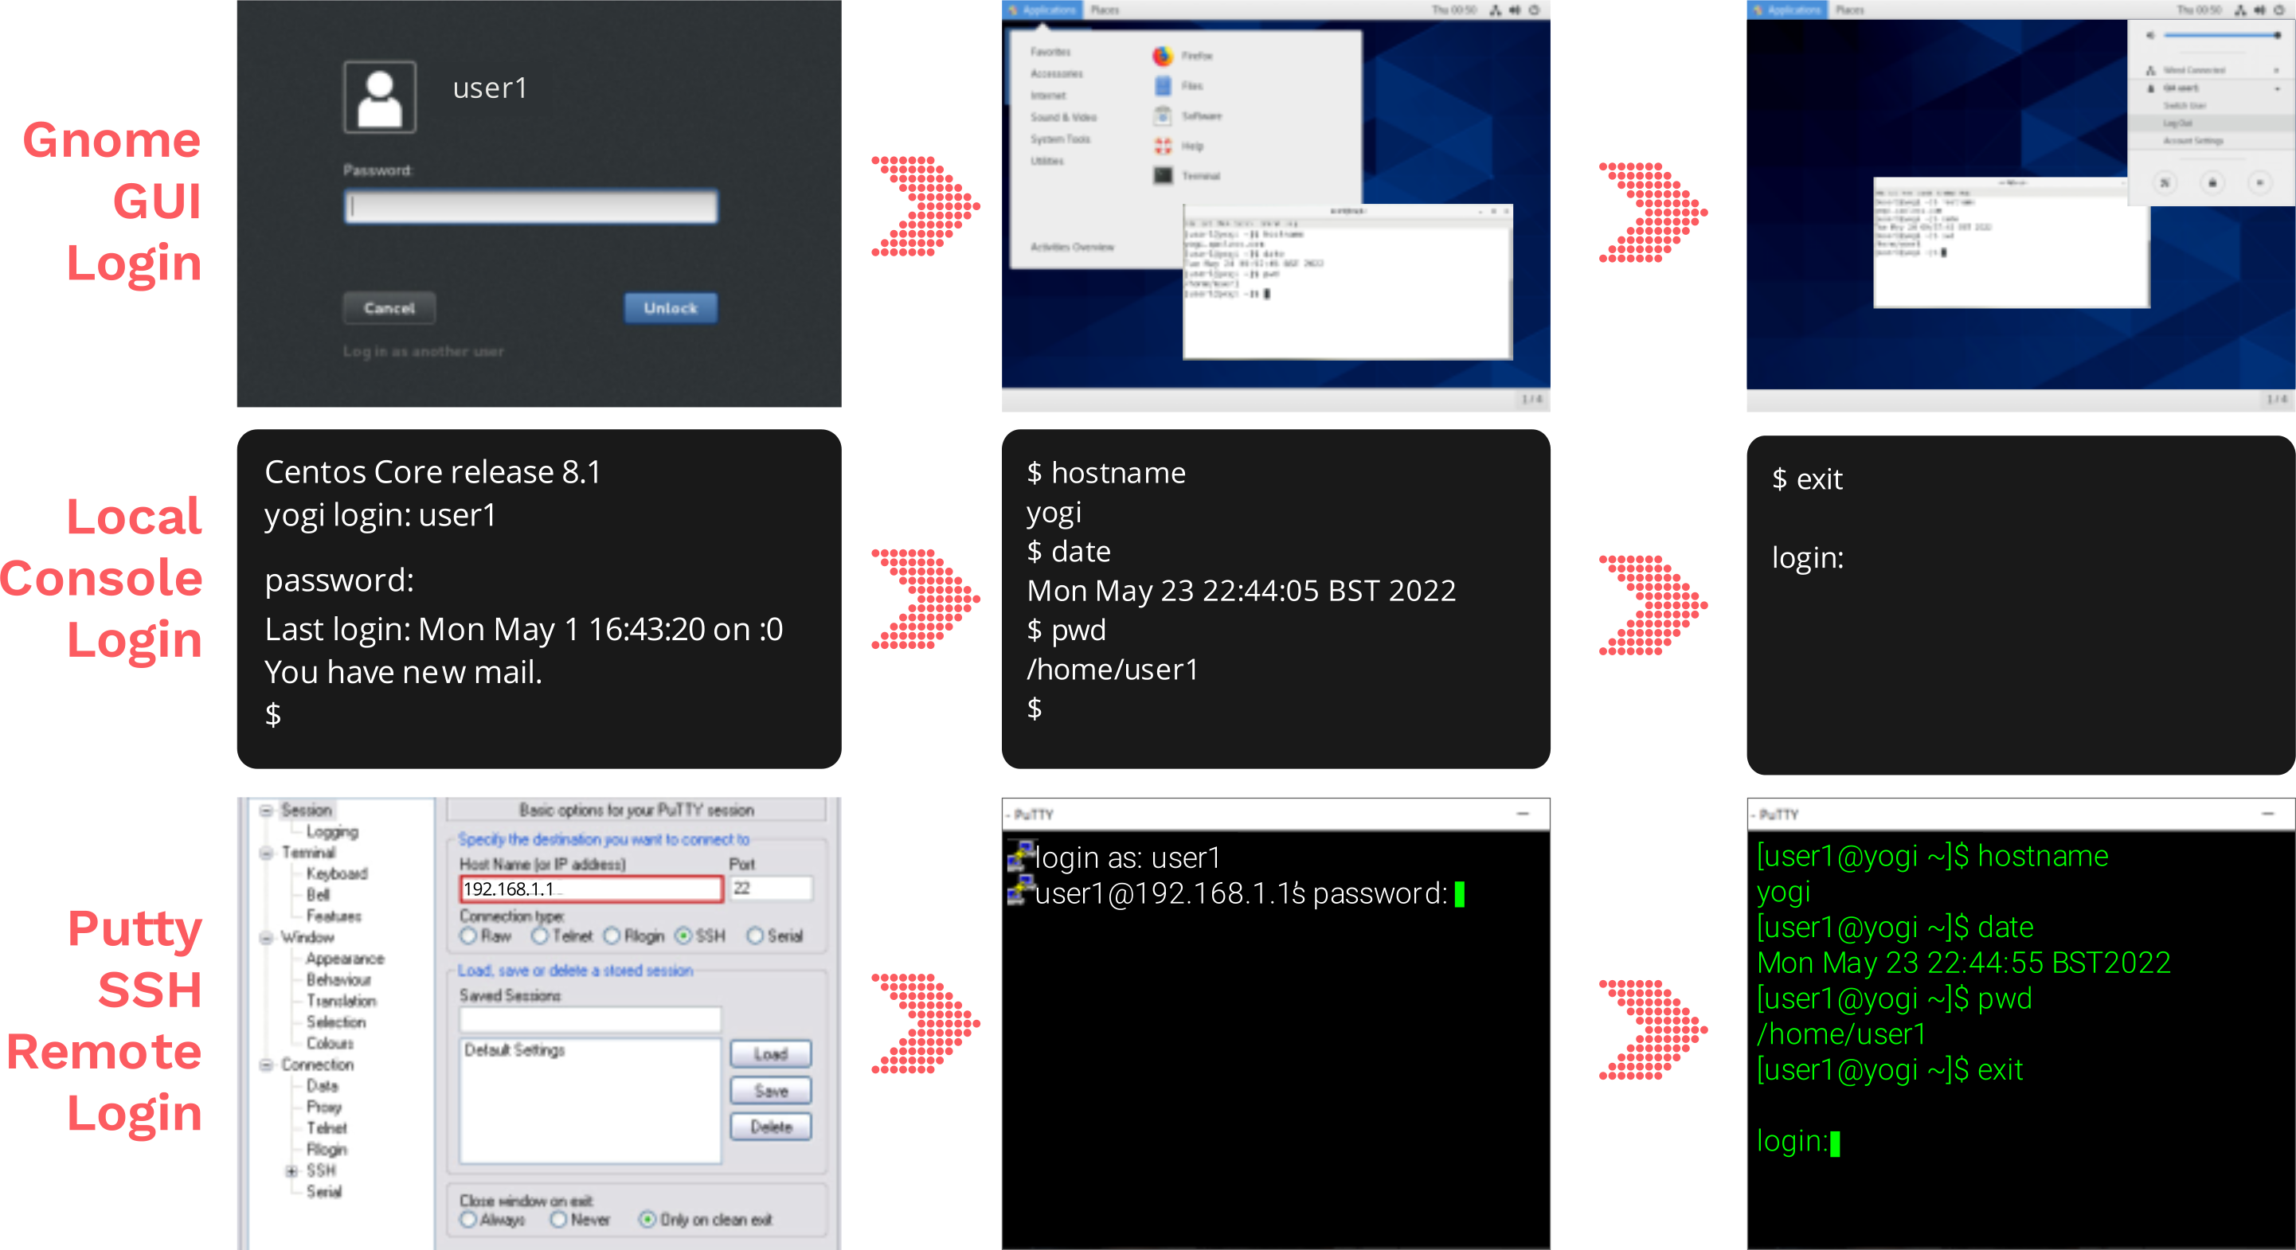
Gaining access to the system
Notes:
This module begins by introducing the typical login sequence for accessing a Linux system. There are three main login methods: two local and one remote.
For local users, access can be via a graphical login (GUI) or a console (non-GUI) login.
The graphical login is managed by processes like gdm or xdm, prompting for a username and password before launching a window manager such as GNOME, KDE, MATE, or Cinnamon.
The console login is handled by the getty (get tty) process, which provides access to multiple virtual consoles. If a graphical session is running, switching to a console may require a keyboard shortcut. After entering login credentials, a shell prompt appears, ready for commands.
For remote access, users log in via SSH (Secure Shell), managed by the sshd daemon. This requires an SSH client like PuTTY, OpenSSH, or SolarPutty. Users must specify the IP address or hostname and enter their credentials. Once authenticated, a Unix terminal emulator opens with a shell prompt.
To log out, console users can use the exit command, while GUI users must select the power/logout option from the desktop environment.

Slide 5
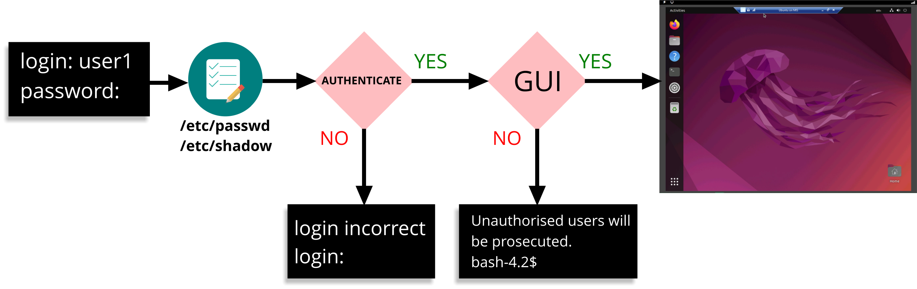
Login steps
Notes:
Linux and Unix are multi-user systems, meaning multiple users can access the system simultaneously. Each authorised user is assigned a username and password, which they must enter to log in before interacting with the operating system.
User account and password configurations are stored in system files within the /etc directory. If the provided credentials match the system’s authentication records, access is granted; otherwise, it is denied.
For text-based logins, a login shell (CLI – Command Line Interface) starts automatically. In a GUI environment, a shell does not run by default—users must launch a Terminal manually from the desktop menu. Terminal sessions started from a GUI are typically non-login shells, meaning they follow different initialisation rules than direct text logins.

Slide 6
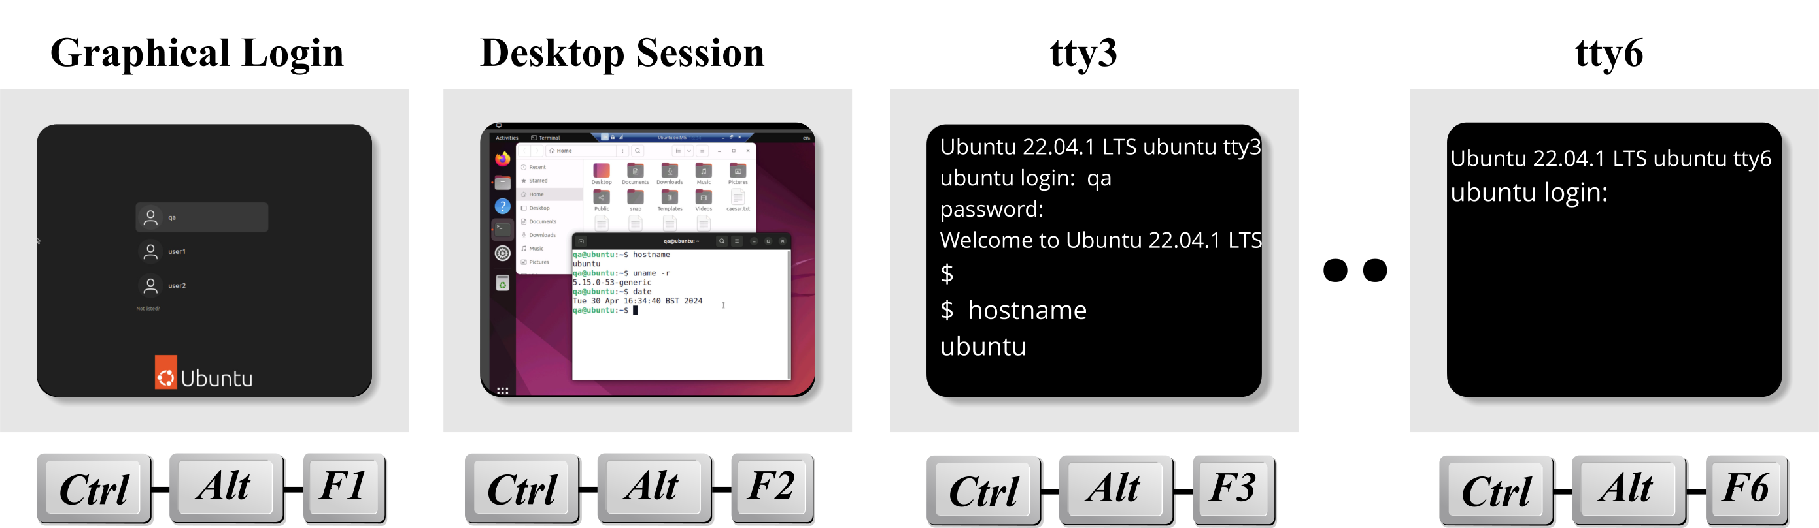
Virtual Text Consoles and Logins
Virtual Text Consoles (TTYs)
Linux provides multiple virtual text consoles (TTYs), each offering an independent login session.
Typically available as tty1-tty6
Each TTY provides its own login session
Useful for administration, troubleshooting, and recovery
One TTY is typically reserved for the graphical desktop
Switching Consoles
Mac/VM users may need to use an alternative key combination to access Linux virtual consoles.
Keys | Action
Ctrl+Alt+F3 | Switch to console tty3
Ctrl+Alt+F6 | Switch to console tty6
Ctrl+Alt+F1/2 | Return to GUI desktop (varies by distro)
Notes:
Linux supports multiple virtual text consoles, often referred to as TTYs (teletype terminals). Each TTY provides an independent text-based login session, allowing multiple users or tasks to run simultaneously on the same system.
Traditionally Linux systems provide six text consoles (tty1–tty6), although the exact configuration can vary between distributions and versions.
Virtual consoles are particularly useful when:
Troubleshooting graphical desktop problems
Performing system administration tasks
Monitoring logs or running long-running commands
Working when a graphical environment is unavailable
You can switch between virtual consoles using keyboard shortcuts such as Ctrl+Alt+F3. The graphical desktop usually occupies one of the virtual terminals, often accessed using Ctrl+Alt+F1 or Ctrl+Alt+F2, although this varies between distributions.
Each virtual console is completely independent, meaning different users can be logged in to different TTYs simultaneously.

Slide 7



Types of Linux User Accounts
Root User
Login name: root
UID: 0
Full administrative control of the system
System Users
Usually cannot log in interactively
Typically have UIDs below 1000
Own files and processes for services such as:
sshd, apache, mysql, mail
Regular Users
Used for day-to-day work
Typically have UIDs of 1000 or higher
Normally restricted to authorised files and directories
Personal files stored in a home directory
Notes:
Linux systems typically contain three categories of user accounts.
The root account is the administrative account and always has a UID of 0. It has unrestricted access to the system and can perform any administrative task.
System user accounts are created to run operating system services and applications such as web servers, database servers and SSH. These accounts usually do not allow interactive logins and exist primarily for security and process isolation.
Regular user accounts are used by people to log in and perform day-to-day work. They are normally assigned UIDs starting at 1000 and are restricted by the Linux permissions system.
Using separate account types improves security by ensuring that services and users operate with only the permissions they require.

Slide 8
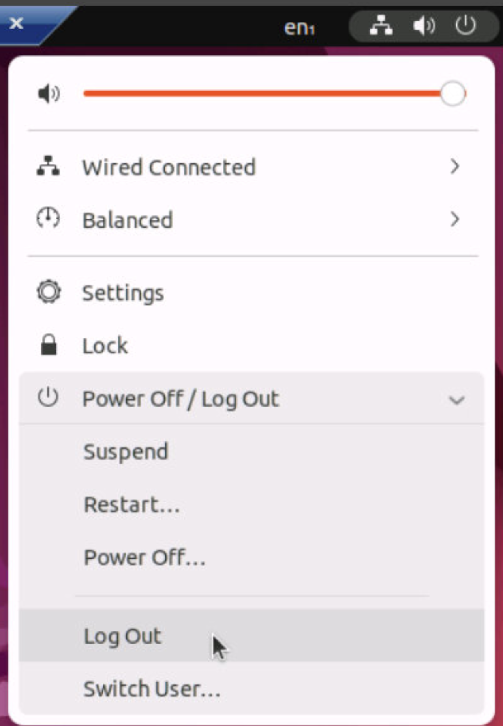
Logging out
Command Line
Use exit to end the current shell session
Press Ctrl+D to send an end-of-file (EOF) signal
A new login prompt is displayed when the session ends
Graphical Desktop
Use the Log Out option to end the graphical session
$ exit
login:
Notes:
When you have finished using a Linux system, you should log out of your session. At the command line, the most common method is to use the exit command. You can also press Ctrl+D, which sends an end-of-file (EOF) signal to the shell and ends the session. Once the shell exits, the login prompt is displayed, ready for another user to log in.
If you are using a graphical desktop environment such as GNOME, use the Log Out option from the system menu to end the session cleanly. Logging out helps ensure that processes are terminated correctly and prevents unauthorised access to your account.

Slide 9
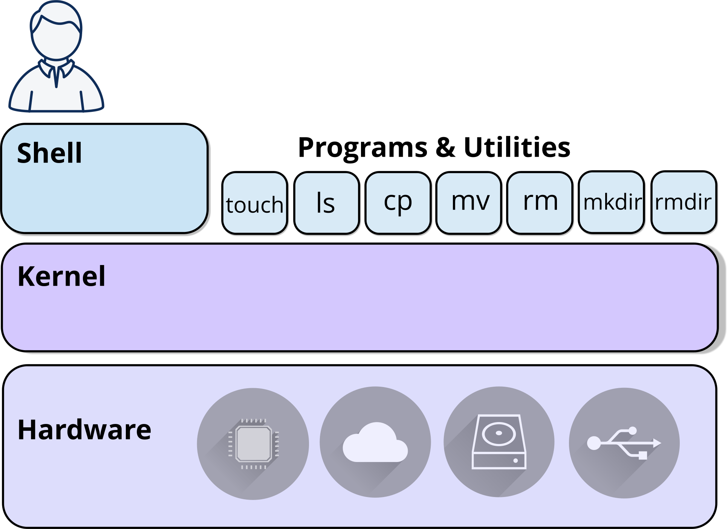
What is a Shell?
A shell is a program that provides a command-line interface to Linux.
Accepts commands from the user
Starts programs and utilities
Displays command output
Acts as an interface between the user and the operating system
Notes:
A shell is a program that provides a command-line interface to Linux. It accepts commands entered by the user, starts programs and utilities, and displays the results on the screen. The shell acts as an intermediary between the user and the Linux operating system, passing commands to the kernel for execution.
Several different shells are available on Linux and UNIX systems. The most common Linux shell is Bash (Bourne Again Shell), which is the default shell on most Linux distributions and is used throughout this course. Other shells include the original Bourne shell (sh), the Korn shell (ksh) which is widely used on commercial UNIX systems, and Z shell (zsh), a modern shell that provides additional features and customisation options.
Although different shells may have slightly different syntax and capabilities, they all perform the same fundamental role of allowing users to interact with the operating system through commands. For most of this course, the commands demonstrated will work in Bash and in many other common Linux shells.

Slide 10
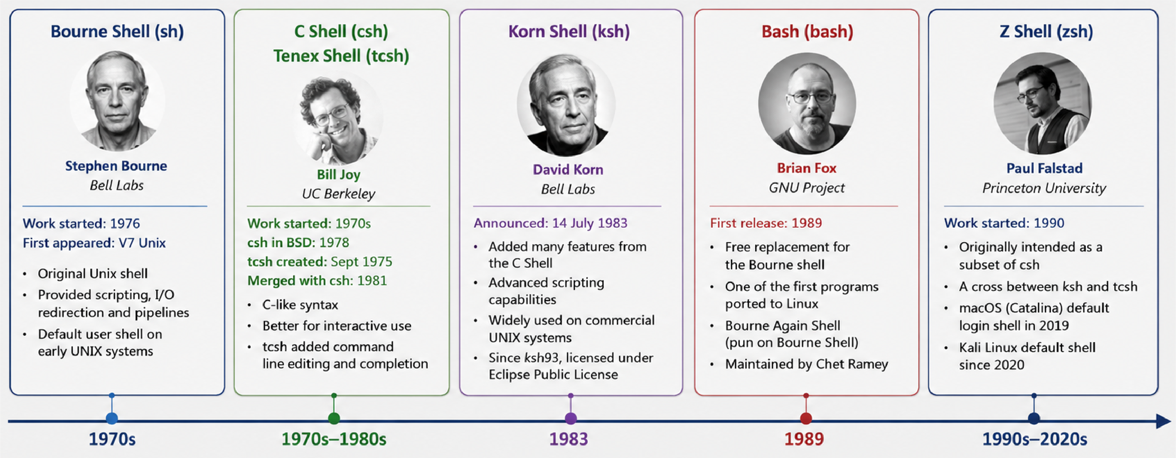
Evolution of the Unix/Linux Shells
Many modern shells evolved from the original Bourne Shell (sh), developed at Bell Labs in the 1970s.
Notes:
A number of shells have been developed throughout the history of UNIX and Linux systems. The original Bourne Shell (sh) was developed by Stephen Bourne at Bell Labs in the 1970s and introduced many of the scripting and command-line features still used today.
The C Shell (csh), developed by Bill Joy, provided a more interactive user experience and used a syntax similar to the C programming language. The enhanced tcsh later added features such as command history and command completion.
The Korn Shell (ksh), created by David Korn, combined the scripting strengths of sh with many of the interactive features of csh and became widely used on commercial UNIX systems.
The Bourne Again Shell (bash) was released by Brian Fox as part of the GNU Project in 1989. Bash became the default shell on most Linux distributions and is the shell used throughout this course.
The Z Shell (zsh) was developed by Paul Falstad in 1990 and combines features from several earlier shells. It is now the default shell on modern macOS systems and is popular with many Linux users. While many shells exist, the commands and concepts covered in this course are largely transferable between them.

Slide 11
Common Linux and UNIX Shells
Common Shells:
This course uses the Bash shell (bash)
Display the Bash version:
Shell | Description
bash | Default shell on most Linux systems
zsh | Popular enhanced shell, popular on macOS and Kali Linux
ksh | Korn shell, widely used on commercial UNIX systems
sh | Original Bourne Shell, often used for compatibility scripts
tcsh | Tenex csh, used by some BSD and legacy UNIX systems
$ echo $BASH_VERSION
5.2.15(1)-release
Notes:
Linux and UNIX systems support a variety of command-line shells. A shell is a program that accepts commands from the user and provides an interface to the operating system.
Many modern shells evolved from the original Bourne Shell (sh), developed at Bell Labs in the 1970s. Today, the most common shell on Linux systems is Bash (Bourne Again Shell), which is the shell used throughout this course.
Other shells include Z Shell (zsh), Korn Shell (ksh), and Tenex C Shell (tcsh). Although these shells differ in features and syntax, they all perform the same basic task of allowing users to interact with the operating system from the command line.
Learners who work with commercial UNIX systems may encounter ksh, while macOS users are likely to encounter zsh as the default shell.

Slide 12
The command line
Command Line syntax:
Linux is case-sensitive. Commands are normally entered in lowercase
Options can be single char (short) or descriptive name (long)
-- marks the end of options. Everything that follows is treated as an argument
Use Backspace or Delete to edit the command before pressing Enter
The --help option displays information about a command and its available options
Most commands follow the pattern: command [options] [arguments]
short options
end of options
/home/user1$ ls -a -l -t --color=auto -- /etc /var/log
shell prompt
command
long options
arguments
Notes:
The command line follows a simple structure consisting of a command, optional options, and optional arguments. The shell prompt indicates that the shell is ready to accept a command and is not part of the command itself.
Commands are typically entered in lowercase because Linux is case-sensitive. For example, ls, LS and Ls would be treated as different commands.
Options modify the behaviour of a command. Short options usually begin with a single hyphen (-a, -l), while long options begin with two hyphens (--color=auto, --help).
Arguments provide additional information to the command, such as filenames, directories or other values. In this example, /etc and /var/log are directory arguments supplied to the ls command.
The special marker -- can be used to indicate the end of options. Anything that follows is treated as an argument, even if it begins with a hyphen.
Most Linux commands follow the format: command [options] [arguments]
The Backspace or Delete key can be used to correct typing mistakes before the command is executed.

Slide 13

Entering commands
Examples of Linux commands:
The date command with formatting options:
The cal command with different arguments:
$ cal
June 2026
Su Mo Tu We Th Fr Sa
1 2 3 4 5 6
7 8 9 10 11 12 13
14 15 16 17 18 19 20
21 22 23 24 25 26 27
28 29 30
$ cal 5 1967
May 1967
Su Mo Tu We Th Fr Sa
1 2 3 4 5 6
7 8 9 10 11 12 13
14 15 16 17 18 19 20
21 22 23 24 25 26 27
28 29 30 31
$ date
Thu Jun 4 10:35:18 BST 2026
$ date +%A
Thursday
$ date +%T
10:42:17
$ date +%d/%m/%Y
04/06/2026
Which British club won the European Cup on 25 May 1967?
Celtic F.C
Notes:
Commands are entered at the shell prompt and executed by pressing Enter. Some commands can be run without any additional information, while others accept arguments that modify the output.
The date command displays the current date and time. Formatting options can be supplied to display specific elements such as the day of the week, the current time, or a custom date format.
The cal command displays a calendar. With no arguments it shows the current month. Additional arguments can be used to display a specific month and year, or an entire year.
In the example shown, cal 5 1967 displays the month of May 1967. Learners may recognise the highlighted date of 25 May 1967, when Celtic became the first British football club to win the European Cup, defeating Inter Milan 2–1 in Lisbon.
These examples reinforce the general Linux command format:
command [options] [arguments]
and demonstrate how arguments can change the behaviour and output of a command.

Slide 14
Command Line Editing Keys
Press and hold Ctrl, then press the letter key.
The letter does not need to be uppercase and Shift is not used.
UNIX documentation sometimes shows Ctrl+C as ^C
Use the stty command to display current key settings:
$ stty –a
speed 38400 baud; rows 24; columns 80; line = 0;intr = ^C; quit = ^\; erase = ^h;kill = ^U; eof = ^D;eol = <undef>; eol2 = <undef>;start = ^Q; stop = ^S;susp = ^Z; rprnt = ^R;werase = ^W; lnext = ^V;
Key | Action
Ctrl+H | Delete previous character
Ctrl+W | Delete previous word
Ctrl+U | Delete entire line
Ctrl+C | Interrupt current command
Ctrl+D | End input (may log out the shell)
Ctrl+Z | Suspend current command
Notes:
The shell provides several keyboard shortcuts that make command-line work quicker and more efficient. Hold the Ctrl key and press the specified letter key; Shift is not required. Ctrl+C interrupts a running command, Ctrl+U clears the current command line, Ctrl+W removes the previous word, and Ctrl+D signals end-of-input, which may log out the shell. UNIX documentation often represents these combinations using notation such as ^C and ^D. The stty -a command displays the terminal settings that define which control characters perform these actions.

Slide 15
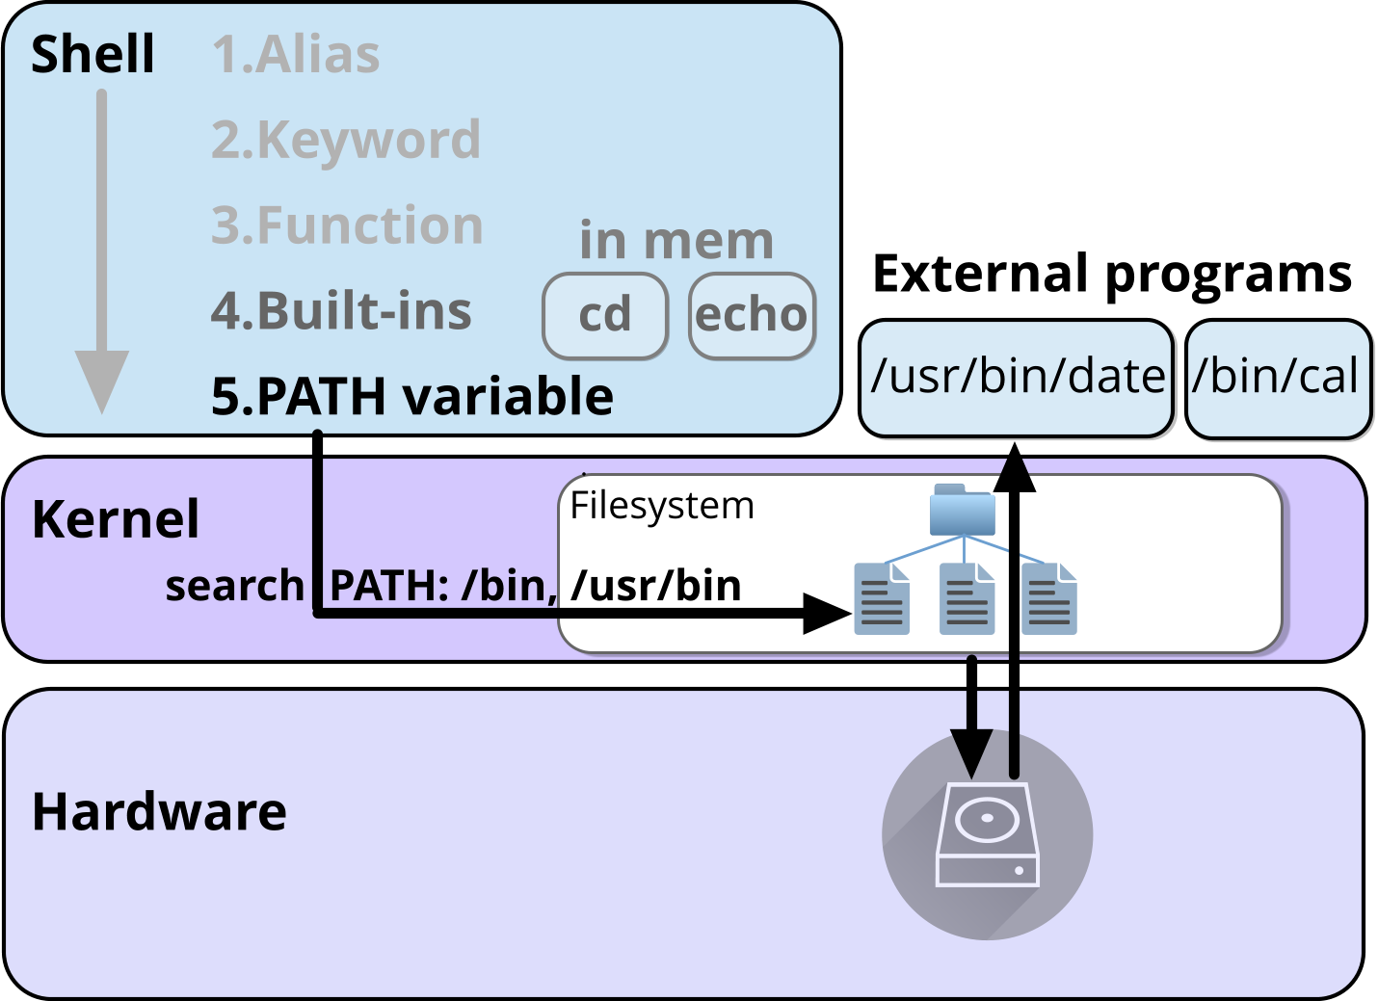
How Linux Finds Commands
When you enter a command, the shell searches for it:
The shell searches for commands in a defined order
Built-ins and shell functions are already available in memory
External commands are stored as files on disk
The PATH environment variable tells the shell where to search for external commands
Find the type of command:
Use which to display the location of an external command
$ type cd
cd is a shell builtin
$ type date
date is /usr/bin/date
$ which date
/usr/bin/date
Notes:
When a command is entered, the shell searches for it in a defined order. It first checks aliases, keywords, functions and built-ins already available in memory. If no match is found, the shell searches the directories listed in the PATH environment variable. External commands such as date and cal are stored as files on disk, typically in locations such as /bin or /usr/bin. The type command can identify how the shell interprets a command, while which displays the location of an external command found through PATH.

Slide 16
Knowledge check
Identify the different parts of this command line:
Parts to Identify:
Command
Short option
Long option
End-of-options marker
Argument
/home/user1$ ls -l --color=auto -- /etc
Notes:
This knowledge check reinforces the structure of a Linux command line. Learners should be able to identify the command, short options, long options, the end-of-options marker (--), and any arguments. The command is the only mandatory component; options and arguments are optional depending on what the command is being asked to do.

Slide 17
Help
Look up things

Slide 18

Getting help
Linux provides several sources of help and documentation:
Local documentation
man — traditional manual pages
--help — quick command usage summary
help — help for shell built-in commands
info — GNU hypertext documentation
/usr/share/doc — package documentation and examples
Online resources
Vendor documentation
Community forums and websites
Project documentation and GitHub repositories
Notes:
Linux systems provide both local and online sources of documentation. The most common local help systems are the man command, the --help option, and the Bash help command for shell built-ins. Many packages also install documentation under /usr/share/doc. Online resources include vendor documentation, project websites, community forums, and source-code repositories. In this course we will focus primarily on man, --help, and help.

Slide 19
Man – Manual Pages
Linux includes built-in documentation called manual pages (man pages).
To display the documentation for the ls command:
To display the documentation for the /etc/passwd file in section 5:
To search man page descriptions for a keyword:
Documentation even exists for the man command:
Manual pages are organised into numbered sections:
Sections 1, 5 and 8 are used often by users
The same name can exist in multiple sections. For example, passwd(1) and passwd(5) describe different things.
$ man date
Section | Contents
1 | User commands and programs
2 | System calls (kernel functions)
3 | Library functions
4 | Special files and device files
5 | Configuration files and file formats
6 | Games and screensavers
7 | Conventions and standards
8 | System administration commands
$ man 5 passwd
$ man –k edit
$ man man
Notes:
The man command displays documentation for commands, utilities, configuration files and other system components. For example, man date displays the manual page for the date command. Manual pages are organised into numbered sections. Section 1 contains user commands, section 5 contains configuration files and file formats, and section 8 contains system administration commands.
The same name can appear in multiple sections, such as passwd(1) and passwd(5), so a section number can be specified when required. Use man -k keyword to search manual page descriptions for related topics.

Slide 20
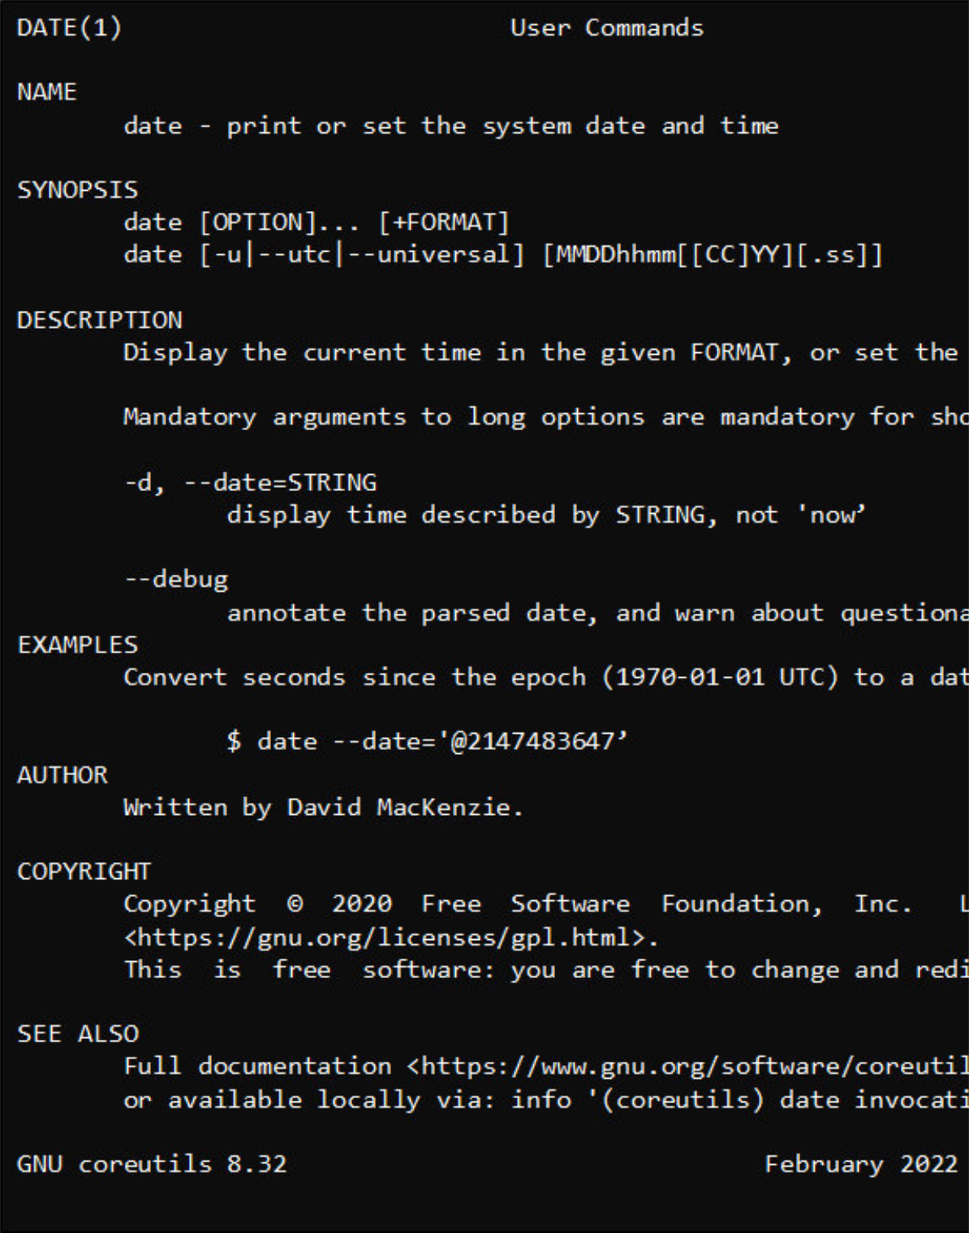
Understanding Man Pages
Command name
Synopsis – summary of command line
Common sections you will encounter:
NAME – what the command does
SYNOPSIS – command syntax
DESCRIPTION – detailed explanation and options
EXAMPLES – common usage examples
SEE ALSO – related commands
Useful keys:
Description, options and details
Examples
Key | Action
Space | Next page
b | Previous page
/text | Search for text
n | Next search match
q | Quit and return to shell
Author & copyright
See also – related commands
Notes:
Manual pages follow a broadly consistent structure. The NAME section provides a short summary of the command, SYNOPSIS shows the command syntax, DESCRIPTION explains the command and its options, EXAMPLES provide common usage examples, and SEE ALSO lists related commands. Manual pages are displayed using a pager, allowing you to move through the document and search for text. Common keys include Space to move to the next page, b to move back, /text to search, n to move to the next search match, and q to quit and return to the shell.

Slide 21

Other sources of Help
Many commands provide built-in help using (double hyphen) --help
GNU systems also include the info documentation system
Use --help for quick syntax and common options and info for detailed guidance
Example of built-in command help
Example of GNU documentation:
$ date –help
Usage: date [OPTION]... [+FORMAT]
Display or set the system date and time
...
$ info date
File: coreutils.info, Node: date invocation
‘date’: Print or set the system date and time
....
Notes:
Most Linux commands provide built-in help through the --help option. This is often the quickest way to check command syntax and common options. GNU systems also include the info documentation system, which provides more detailed documentation and navigation between related topics.
In practice, many users use --help for quick reminders and man for detailed reference information.

Slide 22


Useful Online Resources
Resource | Purpose
https://kernel.org/ | Official Linux Kernel site
https://wiki.archlinux.org/ | Probably the best Linux knowledge base available
https://explainshell.com/ | Fantastic for beginners learning command syntax
https://crontab.guru/ | Extremely useful reference tool
https://linuxfoundation.org/ | Industry body and learning resources
https://distrowatch.com/ | Useful for exploring distributions
https://itsfoss.com/ | Beginner-friendly tutorials
https://linux-hardware.org/ | Hardware compatibility checks
Notes:
Linux has a large and active community, with many high-quality online resources available to support learning and troubleshooting. Official project websites, documentation wikis, and community-maintained knowledge bases often provide more up-to-date information than printed manuals.
Some particularly useful resources include the Linux Foundation, ArchWiki, Kernel.org, and It's FOSS. Tools such as ExplainShell can help you understand complex command lines, while Crontab Guru makes it easier to build and verify cron schedules.
When searching for solutions online, always try to use reputable sources and compare information from multiple references, especially when following administrative or security-related advice.

Slide 23
Practical exercise 2 – T1
In the accompanying Exercise Guide

Slide 24
Fact finding commands
Find out things

Slide 25
Finding information about your system
These commands are commonly used to discover information about a Linux system:
Use man <command> to learn more about a command and its options.
Examples
$ date
Wed Jun 4 09:45:12 BST 2026
$ who
donald pts/0 Jun 4 09:30
$ uname –r
6.8.0-62-generic
Command | Purpose
ps | Display active processes
date | Display current date and time
uname | Display system and kernel information
who or w | Show logged-in users
df | Show filesystem space usage
echo | Display text or variable values
Notes:
Linux provides a number of commands for discovering information about the system. These commands can display the current date and time, information about logged-in users, details of running processes, operating system information, and disk usage.
Most Linux commands are entered in lowercase and support optional parameters that modify their behaviour. Learners will use many of these commands throughout the course to investigate and troubleshoot Linux systems.

Slide 26
Viewing text files
Common commands for viewing text files:
cat is most useful for short files.
Use less for large files and cat for short files.
Examples
Command | Purpose
cat <file> | Display the entire file
more <file> | View one screen at a time
less <file> | View a file with scrolling and search
head -n X <file> | Display the first X lines
tail -n X <file> | Display the last X lines
tail -n +X <file> | Display from line X to the end
$ head -n 3 /etc/hosts
127.0.0.1 localhost
192.168.1.1 yogi
192.168.1.2 rocky1
$ tail -n 2 /etc/hosts
192.168.1.10 server1
192.168.1.11 server2
Notes:
Linux provides several commands for displaying the contents of text files. The cat command displays an entire file, while more and less allow the contents to be viewed one screen at a time. The head and tail commands display selected sections of a file, making them useful when working with large log files or configuration files. These commands are commonly used when examining system files and troubleshooting Linux systems.

Slide 27
Searching Text and Counting File Contents
Use these commands to search files and count lines, words, and characters:
grep is commonly used to locate specific information in files
wc -l is often used to count records or lines of output.
Examples
$ grep localhost /etc/hosts
127.0.0.1 localhost
$ wc -l /etc/hosts
27 /etc/hosts
$ wc -w /etc/hosts
120 /etc/hosts
Command | Purpose
grep ‘pattern’ <file> | Search for lines containing a pattern
wc -l <file> | Count lines
wc -w <file> | Count words
wc -c <file> | Count characters
Notes:
The grep command searches files for text that matches a specified pattern. It is one of the most commonly used Linux commands for finding information quickly.
The wc command counts the contents of a file and can display the number of lines, words, or characters. These commands are often combined with other commands and are useful when working with log files, configuration files, and command output.

Slide 28
Review questions
Which is the default shell on most Linux distros?
Which is the default shell on BSD UNIX?
Which pager command is used by the man command on Linux?
Which command shows keyboard control character mappings?
What content type must a file have so that commands such as cat, more, tail, and grep would work correctly?
Which file reading tool is most useful for the purpose of reading system log files (e.g., to read the last few lines of a log file)?
Describe how grep could be useful in reading log files.
Notes:
The Bourne-Again shell, bash.
The Bourne Shell, sh for users and the C-shell, csh for root.
By default, Linux man command uses /usr/bin/less –is to page the information it generates. To confirm this, you can run man man command. Look at the description of the –P option, where all this is explained.
The stty -a command shows current settings for the keyboard control character mappings.
The commands listed in the question all expect to see just plain text.
The tail command allows a quick listing of the last few entries (lines) from a file.
You can filter lines containing a particular string. For example, to find out all logged information about your mouse, you could run: $ grep mouse /var/log/Xorg.0.log

Slide 29
Practical exercise 2 – T2 and T3
In the accompanying Exercise Guide

Slide 30
Summary
In this module you learned how to:
Use a shell to enter and execute Linux commands.
Interpret the basic command format: command [options] [arguments].
Find information about a Linux system using common commands.
View, search and count information in text files.
Access command documentation using man, --help and info.

